Slide 1
Data Reduction

Slide 2
Sometimes you just have too much data
or too much granularity to be useful
or it’s not organized effectively to be easy to interpret
So… reduce it!
Data Reduction includes:
filtering
taking only unique records
down-sampling (e.g., random sample)
sorting
summarizing data (grouping and aggregating)

Slide 3
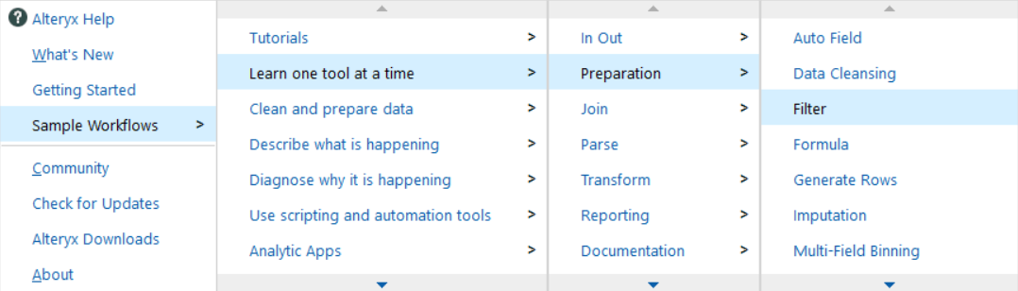
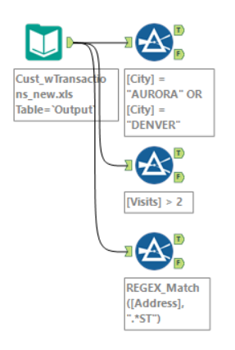
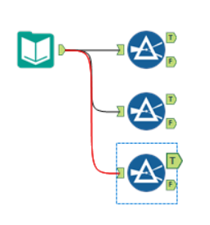
Filter
Using Cust_wTransactions and several Filter tools
select just customers with greater than 2 visits
select just customers in Denver or Aurora
select just customers whose address is on a street (includes “st”)
hint: remember REGEX_MATCH?
remember that you can use https://regex101.com/ to test your regex pattern

Slide 4
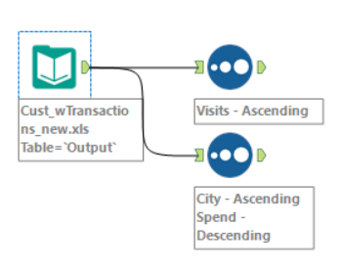
Sort
Using Cust_wTransactions and several Sort tools
Sort by number of visits ascending
Sort by City ascending, followed by Spend descending

Slide 5
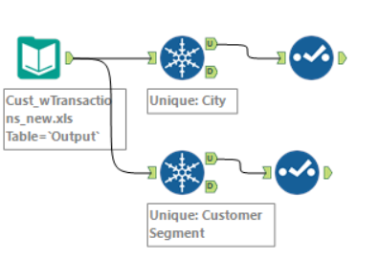
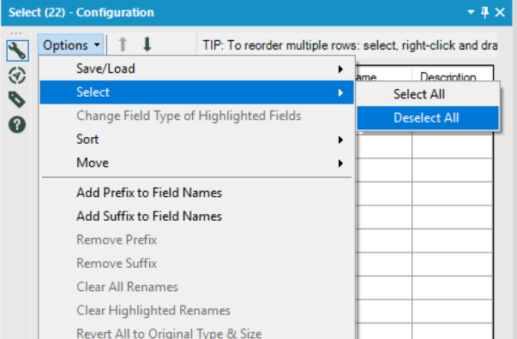
Unique
Only interested in unique records based on some field? Use the Unique tool.
Using several Unique tools and Cust_wTransactions
filter down to only unique cities, then “select” to just show the city field
filter down to only unique customer segments, then “select” to just show that field
Shortcut to “Deselect all” ➔

Slide 6
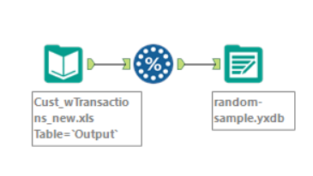
Sampling and Random Sampling
You may only want a subset of records, for your regex large assignment
perhaps using all records takes too long to process, so you test with a subset
Using one “Random % Sample” tool and Cust_wTransactions_new.xls (link)
Take a random sample of 10% of the records
Use a “Output Data” tool to write this sampling to a “.yxdb” file (an alteryx database file)
.yxdb is much faster than reading other kinds of file formats
Later, you would read in your random sample file instead of the original source
Don’t forget to run your final code on the original, full dataset! This is just to speed up testing!
What is a Deterministic seed?
Ensures you get the same “random sample” each time (same sample for a given seed)

Slide 7
Chinese Cellphone Data
real gps locations when users opened an app
from a Kaggle competition
download events.csv
if that’s taking too long, download events_small.csv instead (it’s a random sample of just 10k records from events.csv)

Slide 8
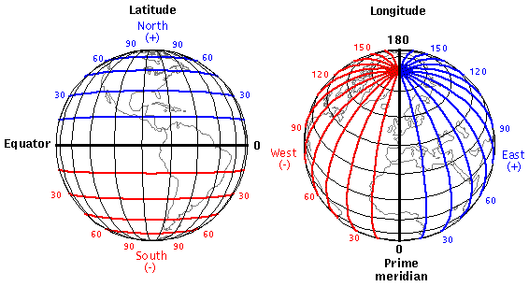

Slide 9

Exploring the cellphone GPS file
Try an “Auto Field” before a “Select”
Examine latitude or longitude field
Notice anything weird?
where is 0, 0?
Filter out any records with absolute value of lat AND lon < 2
Let’s be creepy!
Sort the file by device_id and then by timestamp ascending (do this at some point after the filter)
Choose a device_id. Scroll through and look at the times of day that this person opened the app. This is probably when the person wakes up.

Slide 10
Let’s make points on a map!
Use your workflow from the previous slide
Use a “Create Points” tool followed by a Browse tool to view the points on a map
There are too many records (>3 million), processing is taking forever!
Take a random sample of just 9k records
Let’s say we only care about unique lat-lon pairs. Use a Unique tool to filter to just unique pairs
Use a “Create Points” tool again, followed by a Browse tool to view the points on a map
Bask in the glory of your map
What interesting things do you notice?

Slide 11
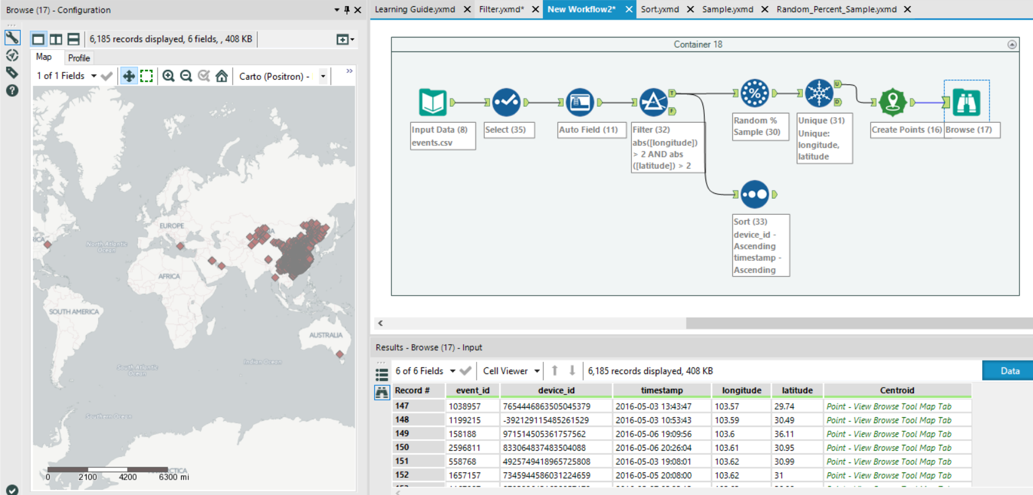

Slide 12
One more creepy thing – Find “home location”
Let’s assume that the earliest in the morning that a person opens the app is when they’re at their home
Extract the “Hour” from the timestamp by using the DateTimeHour() function
Then, sort by device id and then by the extracted hour (multi-level sort)
Then, use the “Sample” tool (not random sample!) to select the “First N Records”, using N = 1, grouping on “device ID”
Filter down to just one “device ID” of your choosing. Plot the point. You now have a good idea of where that person lives.

